Slide 1
Agenda Setting for 2020 Politicians
Atsumi Kainosho, Andrew Olson, Nikita Setia, Haley Townsend

Slide 2

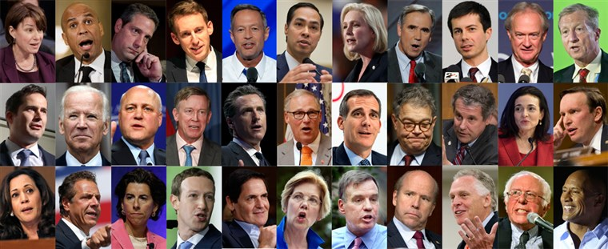

Slide 3
Introduction
5 Components of Agenda Setting:
A serious problem affecting many constituents
A triggering event
An easily understood solution
A political initiator/entrepreneur
The appropriate political mood

Slide 4
Steps to Build the Next Winning Campaign Platform
1.Data Cleaning &
Processing
2.Text Analysis
3.Topic Modeling
Limit press releases to last two years
See when most press releases are released
Condense and clean the topics
Apply NLP to the press releases
Find the most common words
Visualize most frequent words
Use unigrams and bigrams
Perform LDA on unigrams and bigrams
Apply tSNE
Visualize the document-topic proportion matrix

Slide 5
Steps to Build the Next Winning Campaign Platform
4.Sentiment Analysis
5.Clustering & Dim Reduction
6.Recommendations
Apply TextBlob to the documents column
Get polarity and subjectivity score for each topic
Apply Gaussian Mixture Modeling for bigrams and unigrams after choosing the best number of clusters
Topics to focus on given the political mood
Beware of polarizing and/or subjective topics!

Slide 6
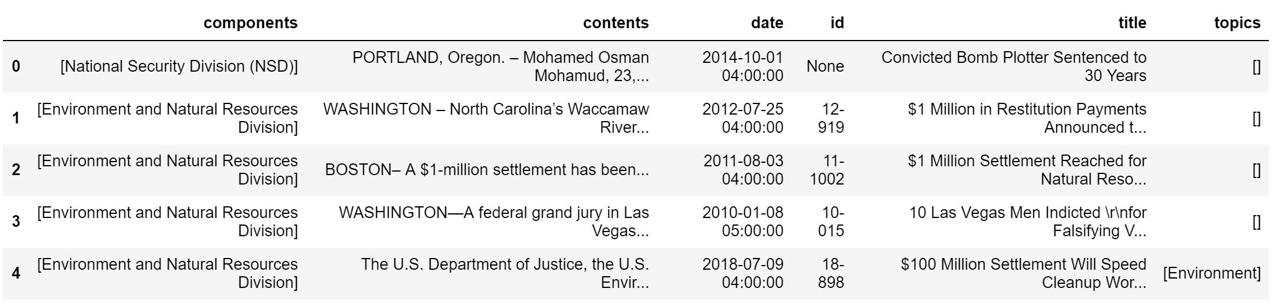
Dataset: Press Releases from the DOJ
13,087 press releases between 2009 and 2018
Data attributes:
Press release number (can be “None”)
Components: Array of agencies and departments
Contents: Release texts (multiple paragraphs)
Released date
ID
Title
Topics

Slide 7
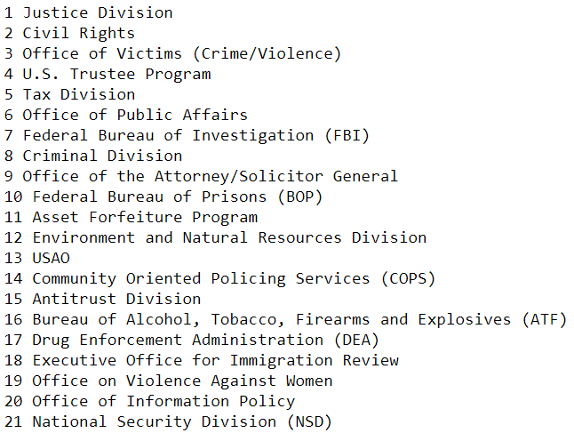
Data Cleaning & Pre-
Processing

Slide 8
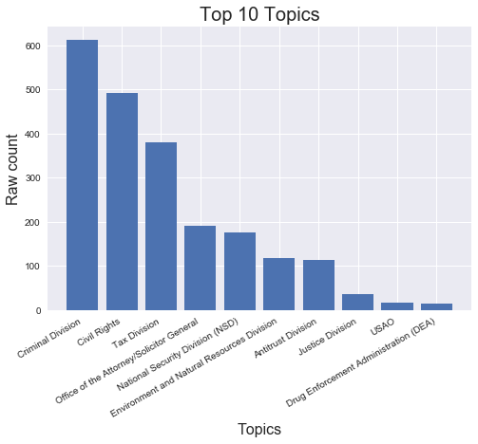
Data Overview

Slide 9
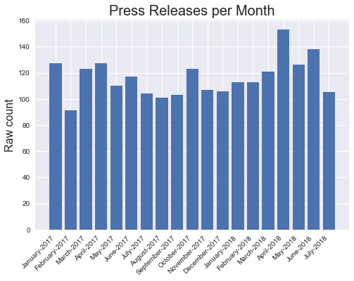
Data Overview

Slide 10
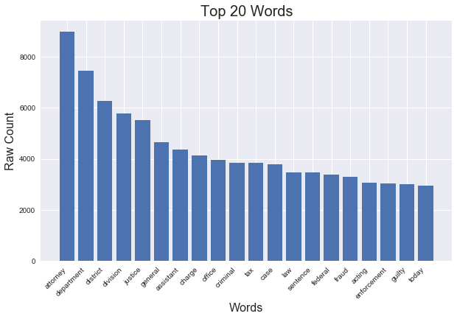
Text Analysis - Unigrams

Slide 11
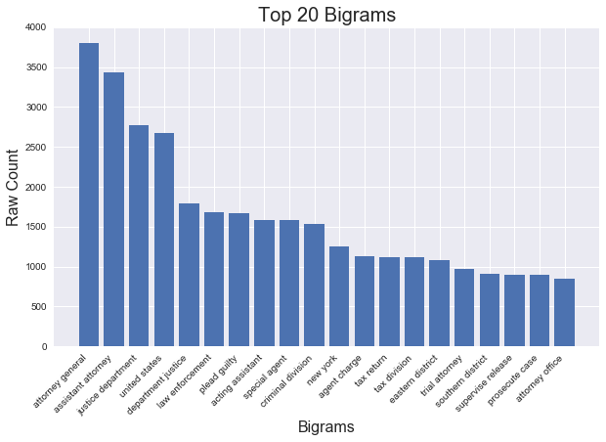
Text Analysis - Bigrams

Slide 12
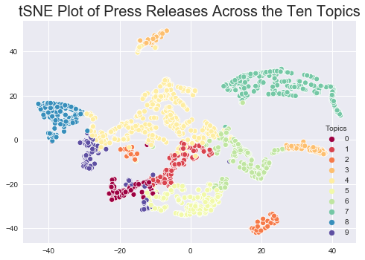
Topic Modeling - Unigrams
TAXES
Healthcare
Immigration+ security
Sex trafficking

Slide 13
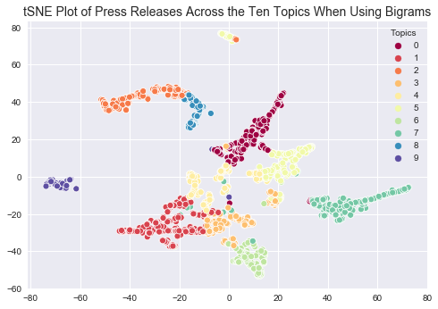
Topic Modeling - Bigrams
TAXES
Sex trafficking
Jeff Sessions
Security

Slide 14
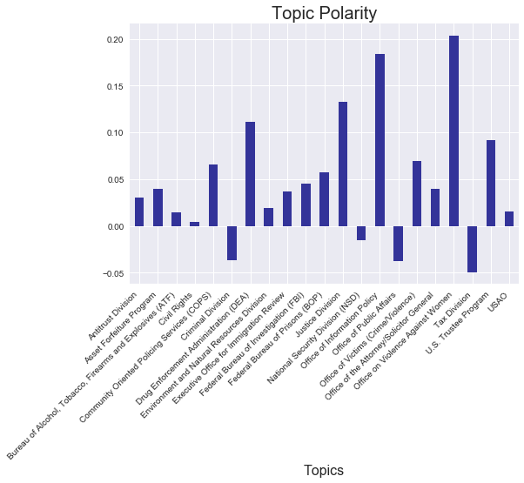
Sentiment
Analysis - Polarity

Slide 15
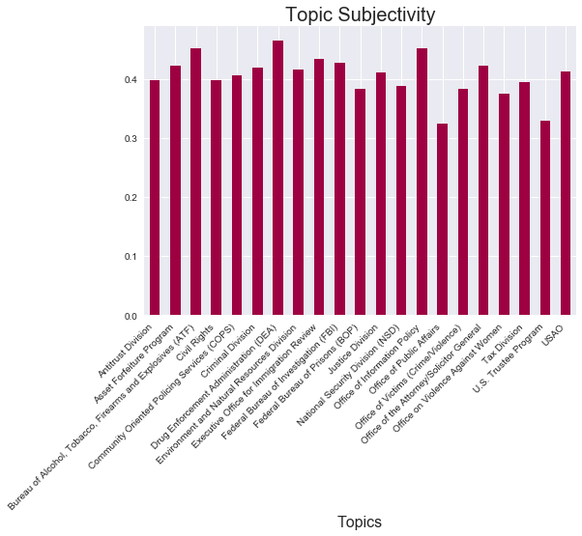
Sentiment
Analysis - Subjectivity

Slide 16
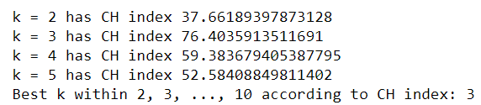
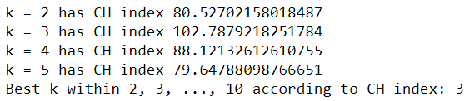
Clustering - Choosing k

Slide 17
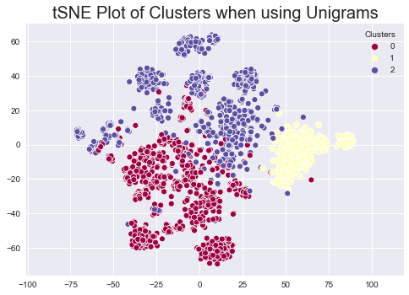
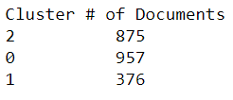
Clustering - GMM with Unigrams

Slide 18
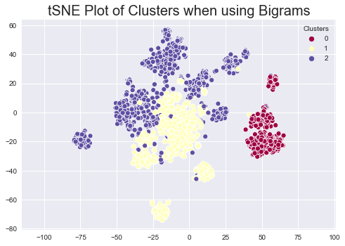
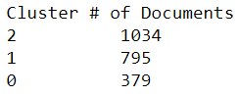
Clustering - GMM with Bigrams

Slide 19
Key Recommendations for Candidates
Topics to focus on:
TAXES, TAXES, TAXES
National Security
Sexual exploitation / trafficking
Healthcare
Understand your constituents and take an early and firm stance!

Slide 20
Challenges
Future Work
Reading and working with JSON
Topics had a lot of NAs (missing data). Plus, lots of topics.
Had to condense the long list of components to create topics
Formal government documents can lack opinion
Incorporate more public opinion sources (e.g. comments, tweets)
For state candidates, would need to zoom into that specific state
Could combine unigrams and bigrams to make more robust feature set

Slide 21

QUESTIONS?

